Slide 1
Reminder:
Clean values in PEEC_demo and open the good sheet prior to the presentation
Have the report opened + GaBi?

Slide 2
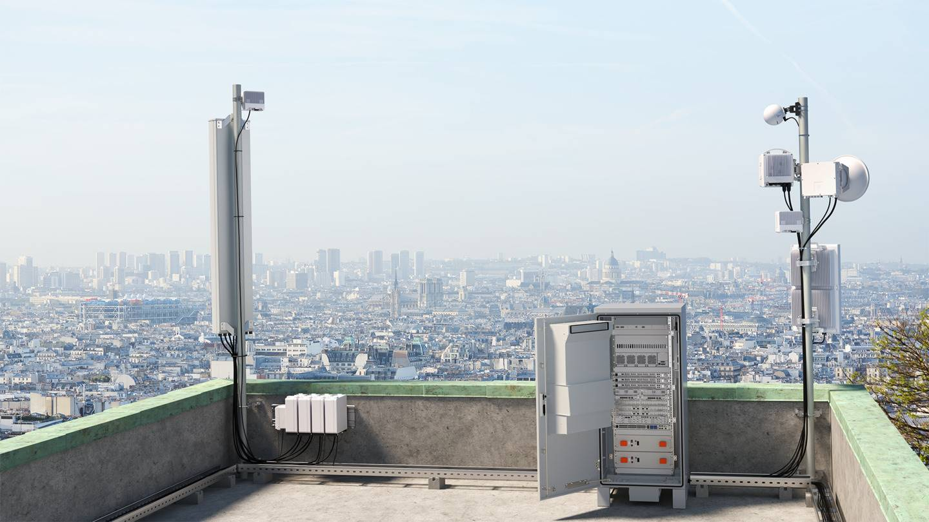
Developing a Parameterized Embodied Emissions Calculator (PEEC) for telecommunication networks equipment
Master’s thesis presentation
Maël Madon

Slide 3
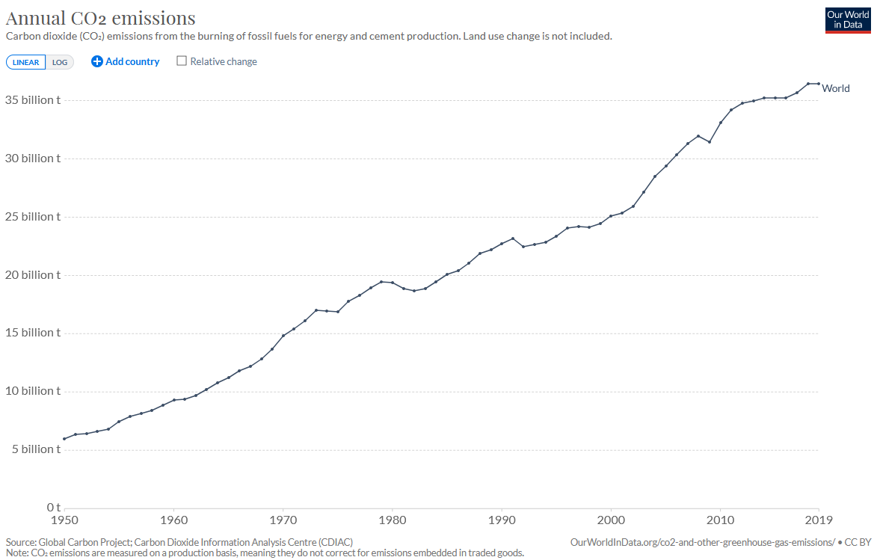
Context
Halved by 2030
Net zero by 2050

Slide 4


Problem
ICT = Information and Communication Technology
Carbon footprint of ICT = rather new field
No consensus in research on ICT footprint (around 1-3% annual emissions)
Few precise environmental assessments of ICT products: even less for telecommunication networks
Challenging CO₂ assessments
Questions from customers and citizens
Evolving CO₂ reporting practices
CO₂

Slide 5
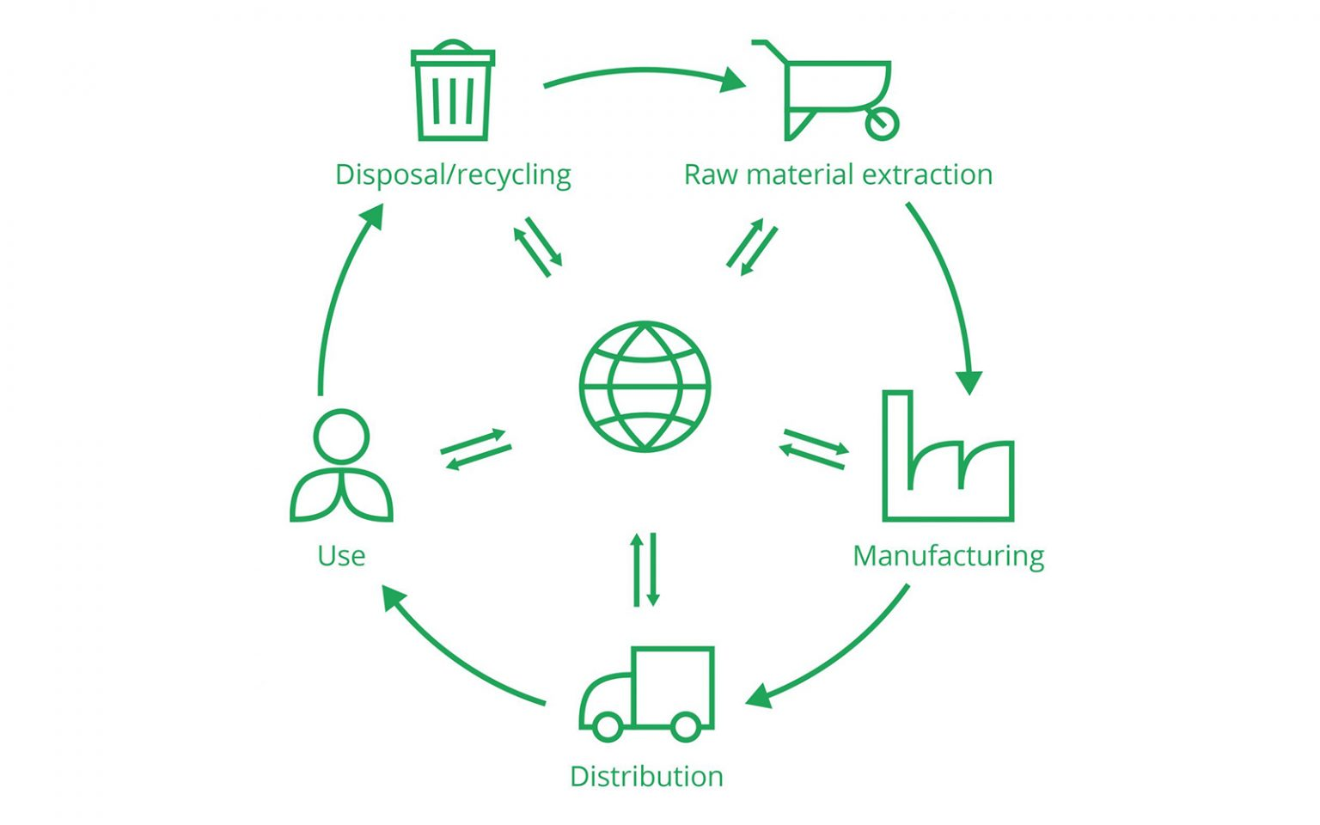
What did I do?
Ericsson Sustainability Research
Focus on
Telecommunication network equipment
Embodied emissions
Usability and simplifications
=> Research question:
How could embodied emissions of telecommunication networks be estimated in a streamlined way?
Embodied emissions
= ”cradle-to-gate” emissions

Slide 6

Outcome of the project
Parameterized Embodied Emission Calculator for telecommunication network equipment
=> DEMO <=
PEEC

Slide 7
Method
Life Cycle Assessment (LCA)
LCA data and tools
User expectations
Workshop on usability
LCA standards
LCA experts
Previous LCA for telecom
Literature on simplified LCA
11 customer requests
Discussion with stakeholders

Slide 8

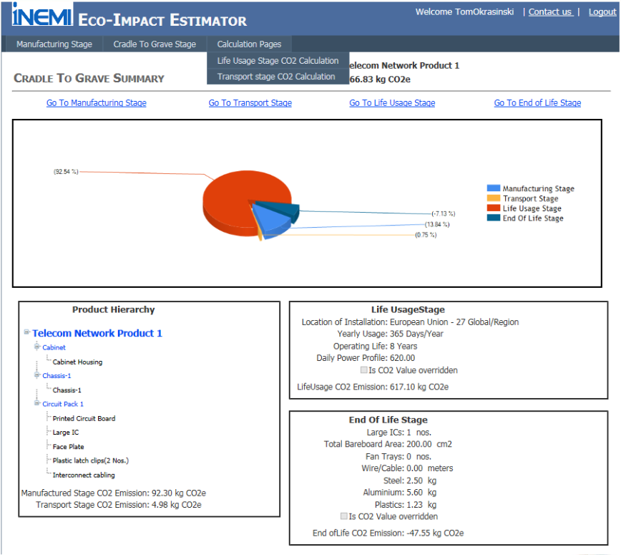
Similar work
PAIA (MIT and Quantis)
iNEMI Eco-Impact Estimator

Slide 9

Limitations
Experimental validation: challenging because no data to test the model against
Comparison with literature
Compliance with standards
Systematic discussion about sources of uncertainties
Sensitivity analysis
Limited scope
Environmental indicators
Life cycle stages included
Limited method to study usability
Quality of the results depend on the quality of data

Slide 10
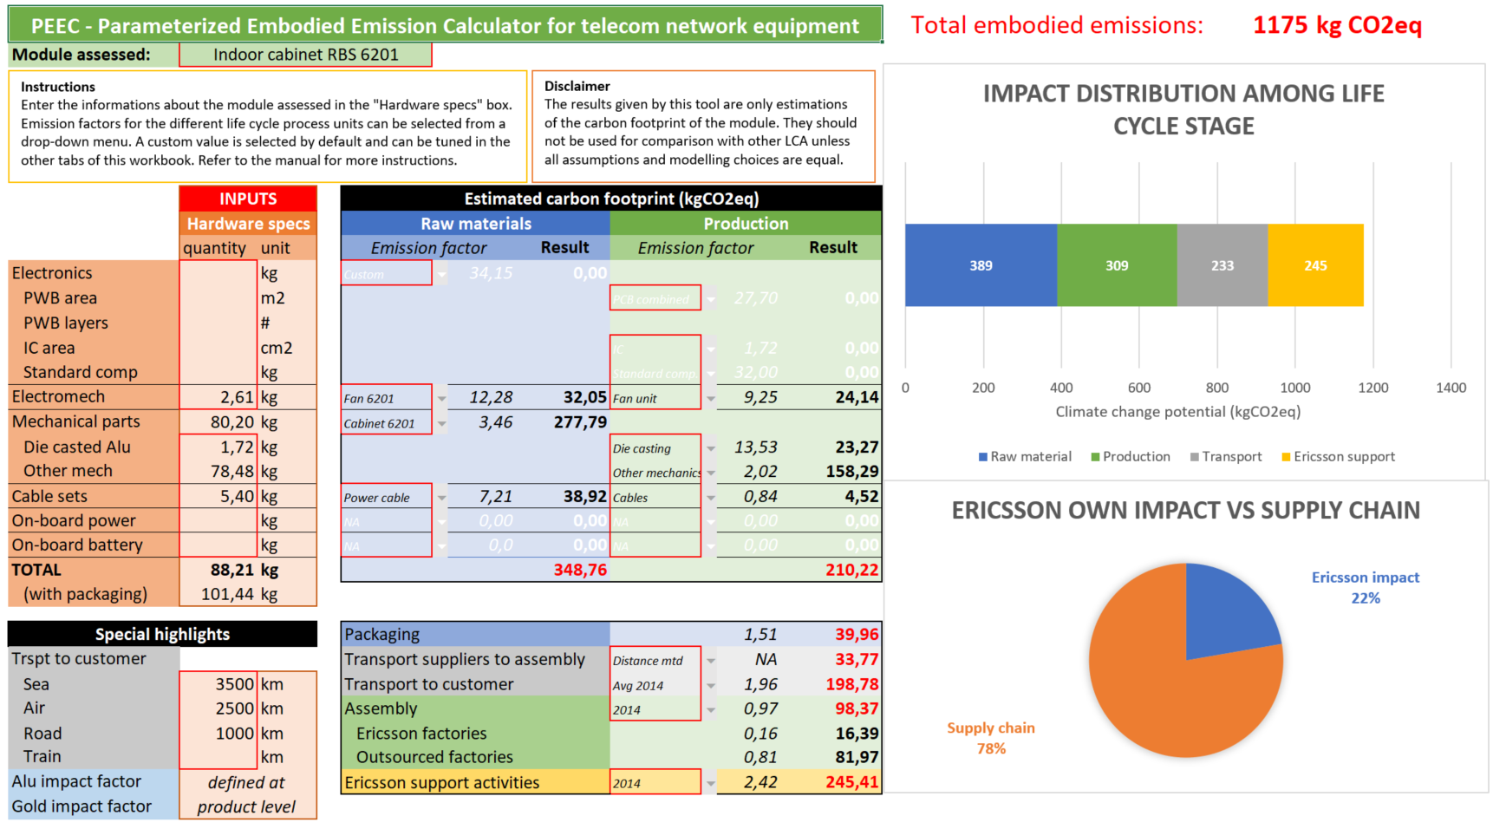
Conclusion
PEEC = carbon footprinter for telecom products
Transparent method
Use case for industry
Report CO₂ emissions
Answer customer questions
Help research projects

Slide 11

Future work
Update data for new products
Material declarations
Energy consumption in production processes
Transport in the supply chain
Include other environmental indicator
Include other life cycle stages
Further study the adoption and validity of the tool
Consider collaboration with existing tools

Slide 12
Thanks for your attention!
Questions and discussion

Slide 13
Sensitivity analysis
Modified parameter | Description | Motivation
Plastics impact factor | Doubled (from 2,5 to 5) | The figure used for plastics is an estimation. We try a more conservative assumption.
Aluminum impact factor | Halved (from 19 to 9,5) | Aluminum emission factor is an influent parameter for telecom products. A lower figure depicts a mix of virgin and recycled aluminum supply.
Gold impact factor | Halved (from 49400 to 24700) | Gold has a very high impact that tends to overwhelm the other materials in the result. We try a lower value (like in other databases).
Raw material input factors | Input waste for all raw materials is doubled (an input factor of 1,1 becomes 1,2) | The extra materials needed as input and wasted during production is estimated in the model. We try a more conservative assumption.
IC emission factor | Doubled (from 1,72 to 3,44) | IC is identified in most LCA for ICT studies as a major contributor. In addition, the figure used in the example is rather low compared to other studies.
Assembly emission factor | Doubled | Assembly is very roughly taken into account. We try a more conservative assumption.
Scenario for support operation | A 75% allocation of overall Ericsson operations is assumed instead of 50% | Allocating support operations to a product is challenging. We try a more conservative assumption.

Slide 14
User review workshop
Is the tool easy to understand without the help of any explanation or documentation?
Participants: approx. 10 within Ericsson
Qualitative feedback after 10 minutes on-boarding experience

